Slide 1

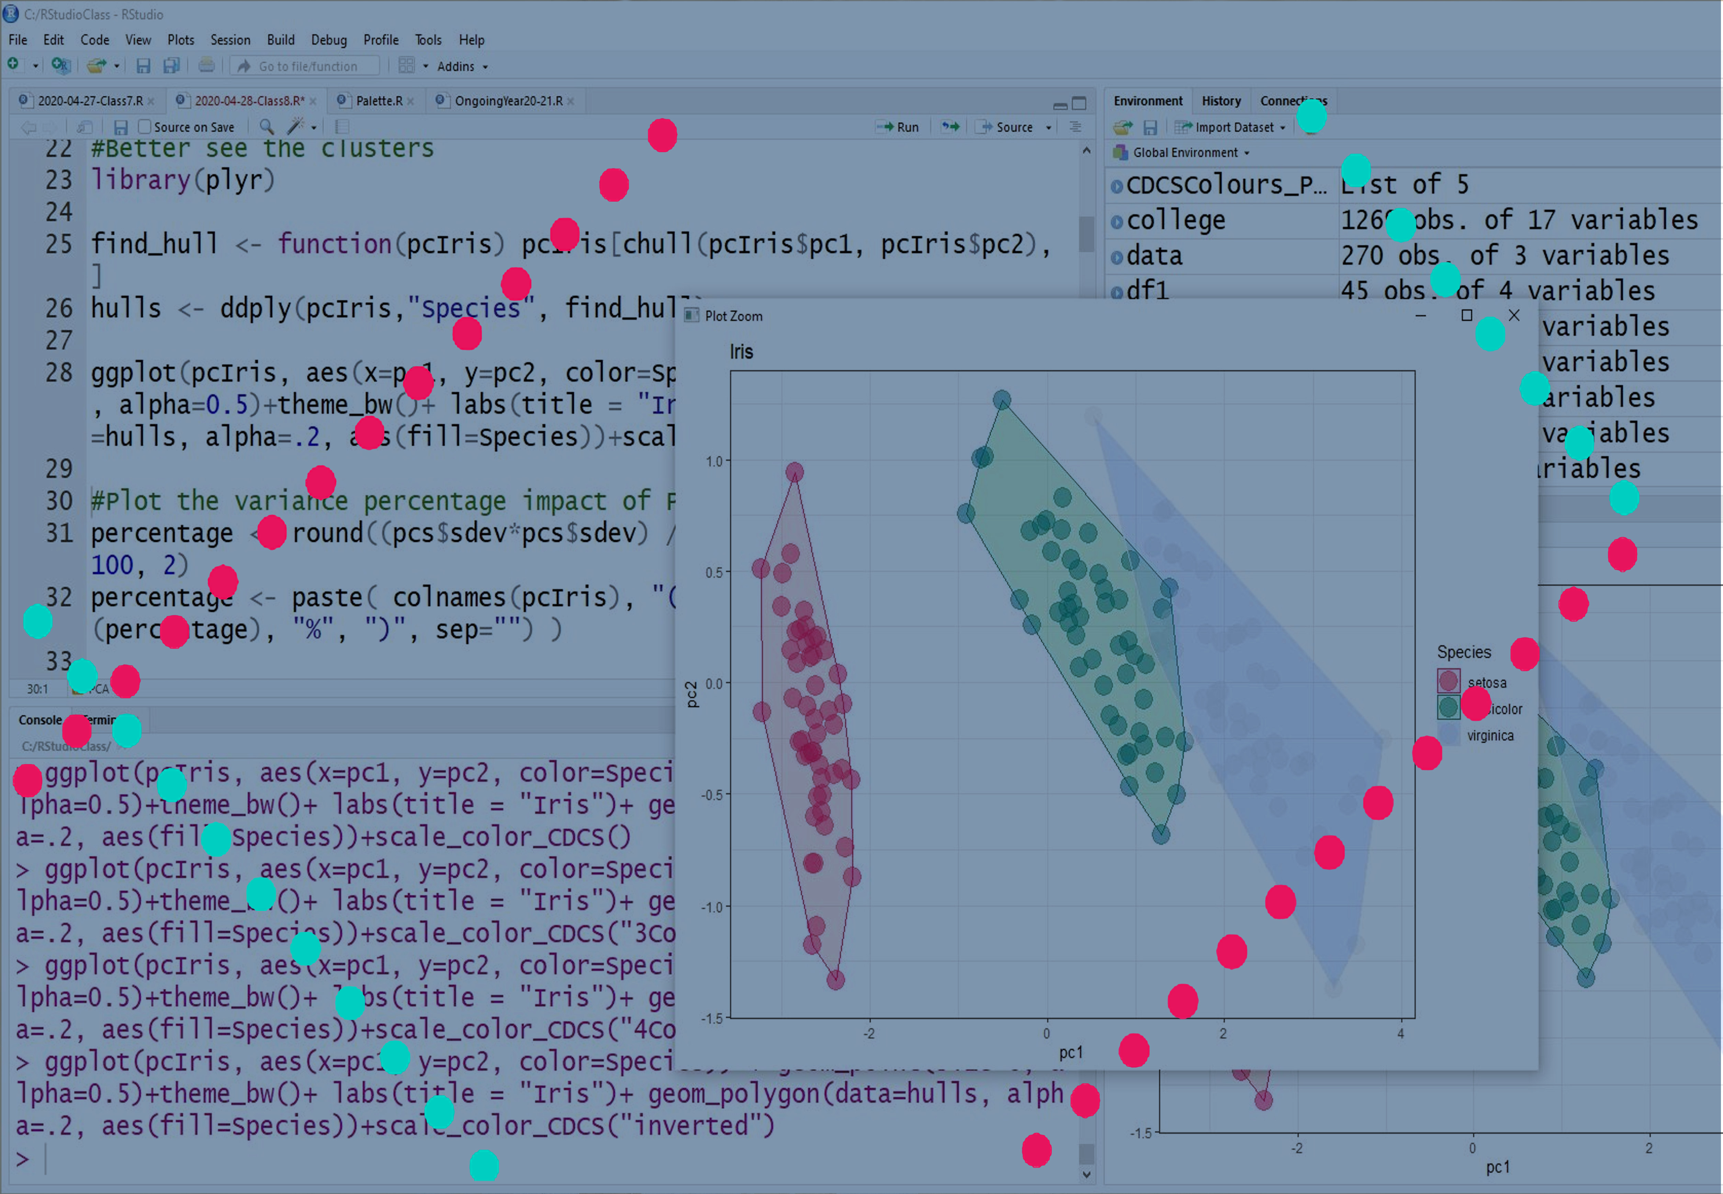
Basic Statistics and Visualisation with R
Lucia.michielin@ed.ac.uk

Slide 2
Today Program
Data Collection
Datesets biases
Comparing distributions
Inferential stats

Slide 3

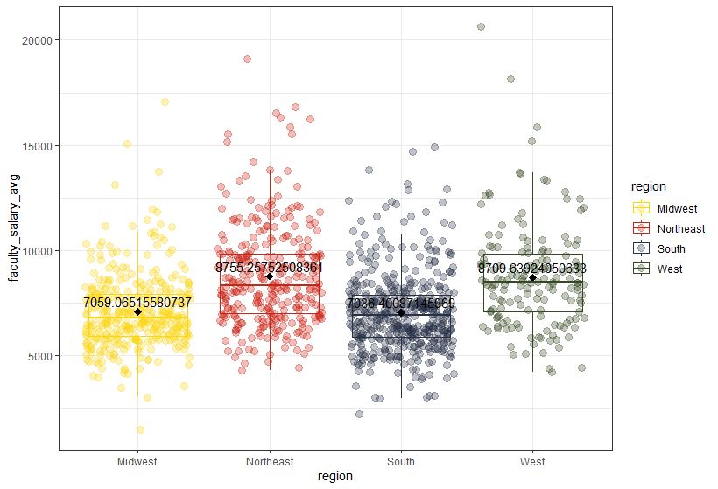

Challenge 3: Solution
www.cdcs.ed.ac.uk

Slide 4

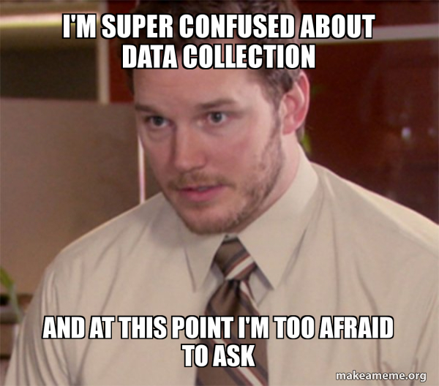
Data Collection
“Data collection is the process of gathering and measuring information on targeted variables in an established system, which then enables one to answer relevant questions and evaluate outcomes.
The goal for all data collection is to capture quality evidence that allows analysis to lead to the formulation of convincing and credible answers to the questions that have been posed”.
Wikipedia
www.cdcs.ed.ac.uk

Slide 5
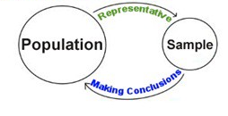
Sample Vs Population
Sample
Is a set of individuals or objects collected or selected. In the ideal world is the randomly selected subsample representative of the reality on which you are going to perform the analysis.
Population
Is the theoretically full dataset of all the possible occurrences (e.g. all the newspaper published in the XX century). Inferential Statistic start from the sample to infer conclusions on the population
The real question is:
How sure I am that my sample is representative of the population?
www.cdcs.ed.ac.uk

Slide 6
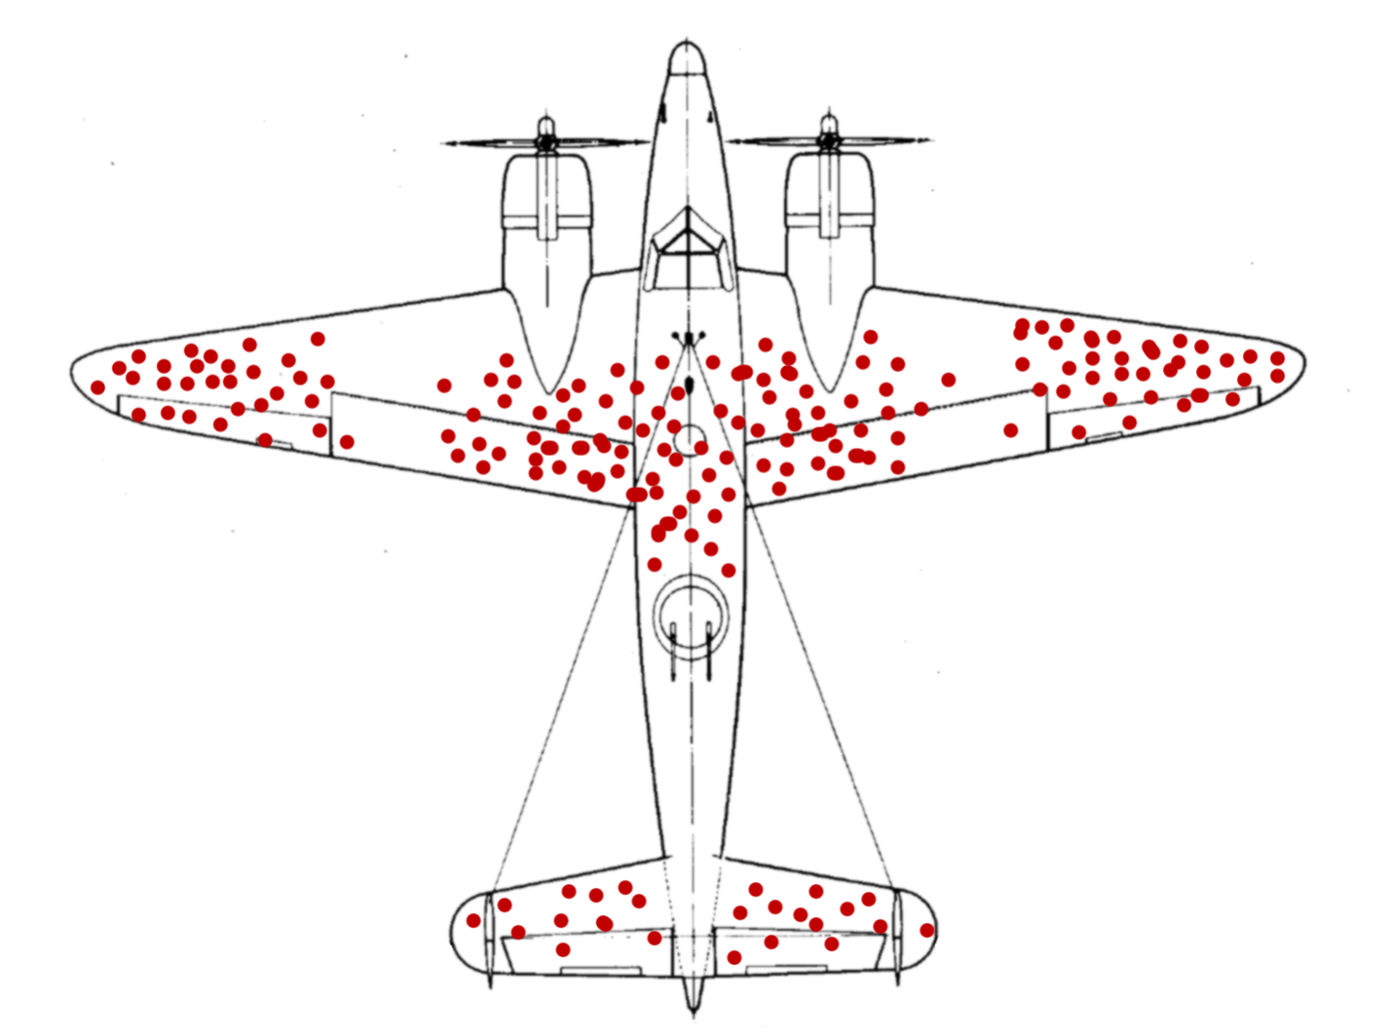
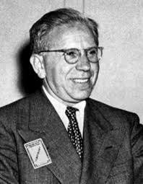
Understanding Data
During WW2 was conducted a study aimed to understand which parts of the airplanes needed to be fortified to increase
Can you see what is wrong with it?
Abraham Wald
www.cdcs.ed.ac.uk

Slide 7
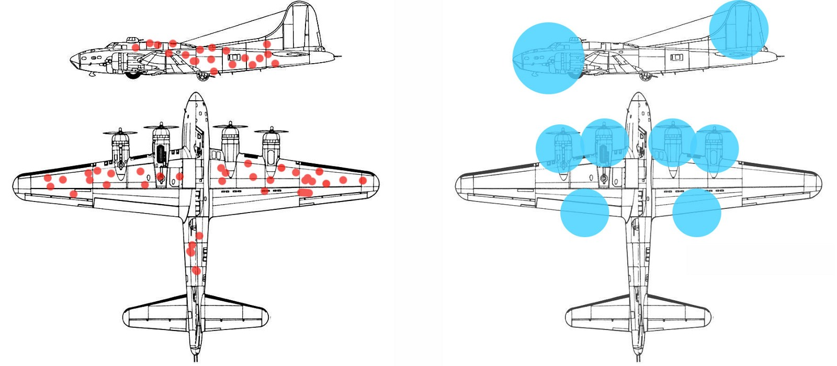
The Surviviorship Bias
www.cdcs.ed.ac.uk

Slide 8
Intensity Bias
Pay attention to data concentrations and empty areas due to lack of data preserved
www.cdcs.ed.ac.uk

Slide 9
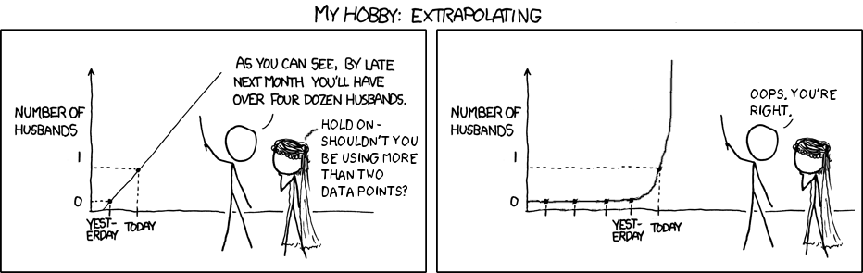
Bottom line
Before moving from Descriptive stats to Inferal stats you need to be sure to know well your sample and be honest on the data collection limitations
www.cdcs.ed.ac.uk

Slide 10

Assess Probability
“Probability is a numerical description of how likely an event is to occur or how likely it is that a proposition is true”
Wikipedia
www.cdcs.ed.ac.uk

Slide 11
Let’s step back
In Republican areas (A) Private Universities are more diffuse (B)
If A is true then B is true
If an area has more Private Universities is it a Republican Area ?
If B is true then A is true?
Do you agree?
www.cdcs.ed.ac.uk

Slide 12
What if I add the probability
In Republican areas (A) Private Universities are more diffuse (B)
If A is true then B is true
If an area has more Private Universities is it a Republican Area ?
If B is true then A is more plausible
www.cdcs.ed.ac.uk

Slide 13
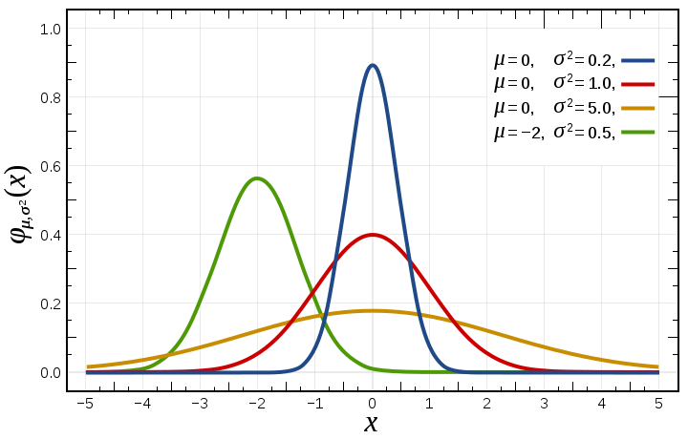
Normal Distribution
Normal distribuion centrals on the average values
Width of curve defined by standard deviation
A random sample of reality shall normally have a normal distribution
www.cdcs.ed.ac.uk

Slide 14
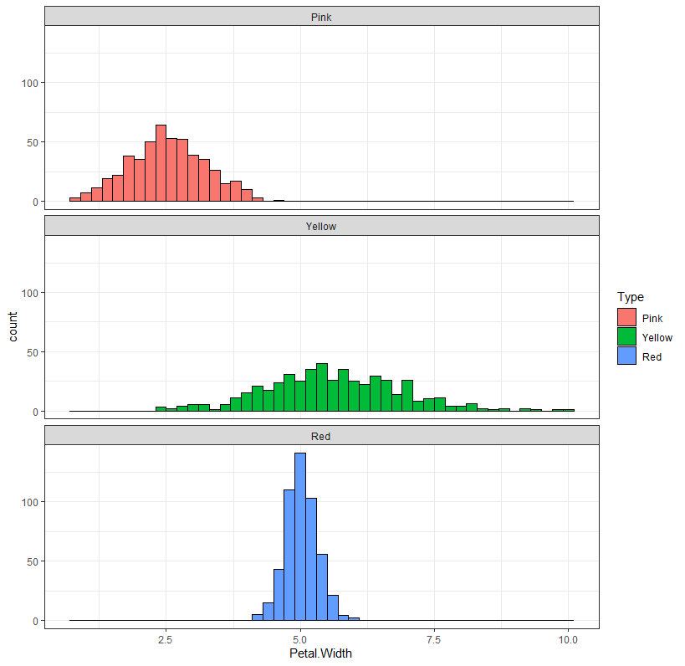
Normal distribution
Roses Sample
www.cdcs.ed.ac.uk

Slide 15
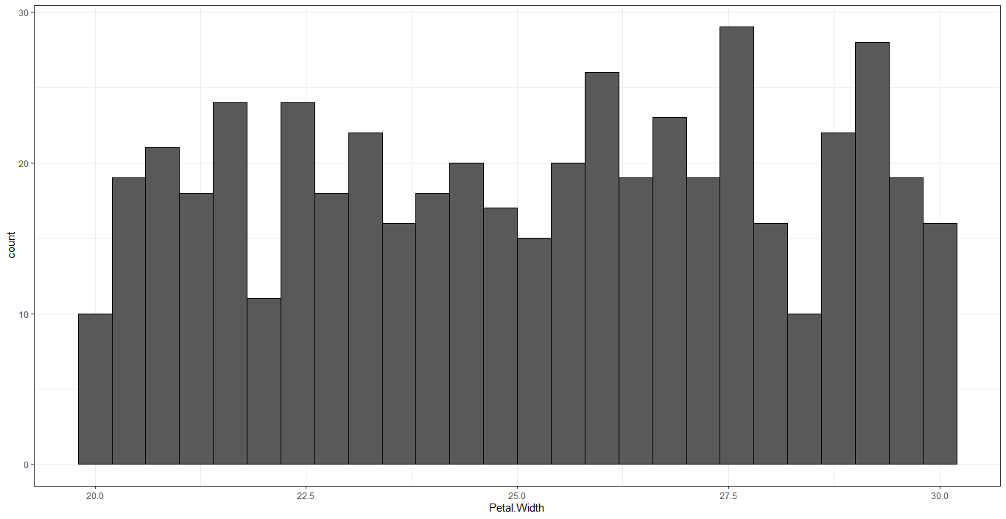
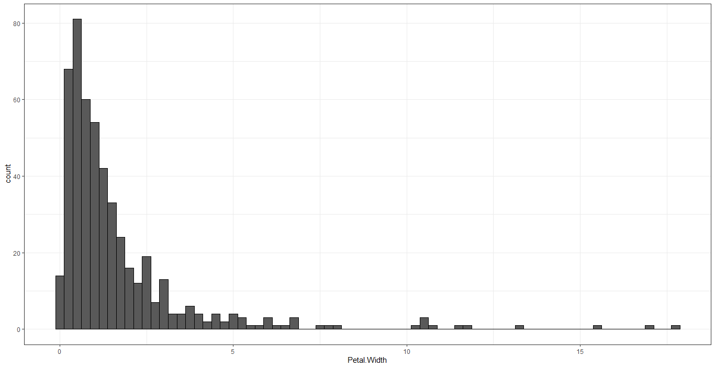
Other types of distribution
Uniform Distribution
Logarithmic Distribution
www.cdcs.ed.ac.uk

Slide 16
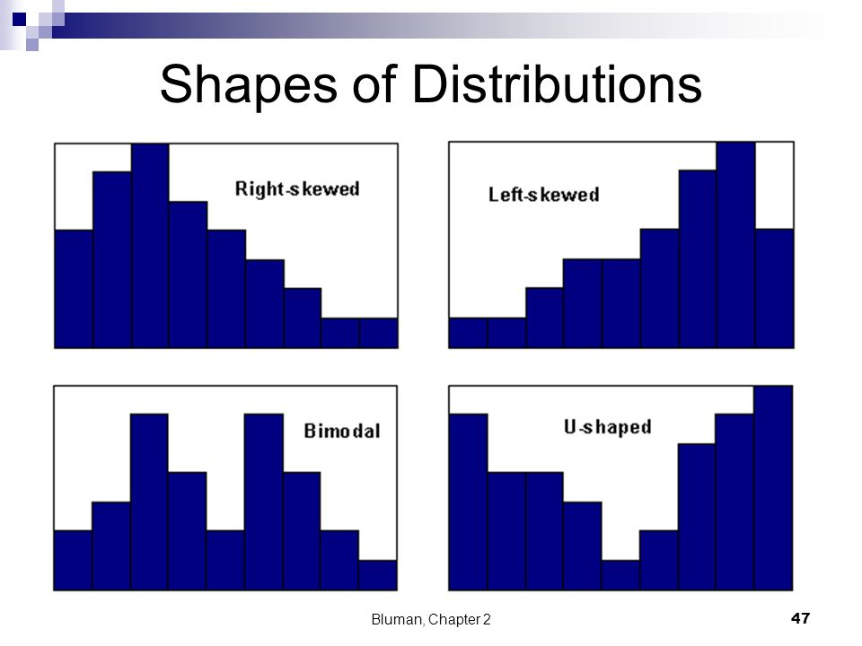
<
Right Skewed left Skewed and Bimodal
Median > Mean
Mean > Median
2 Modes
www.cdcs.ed.ac.uk

Slide 17
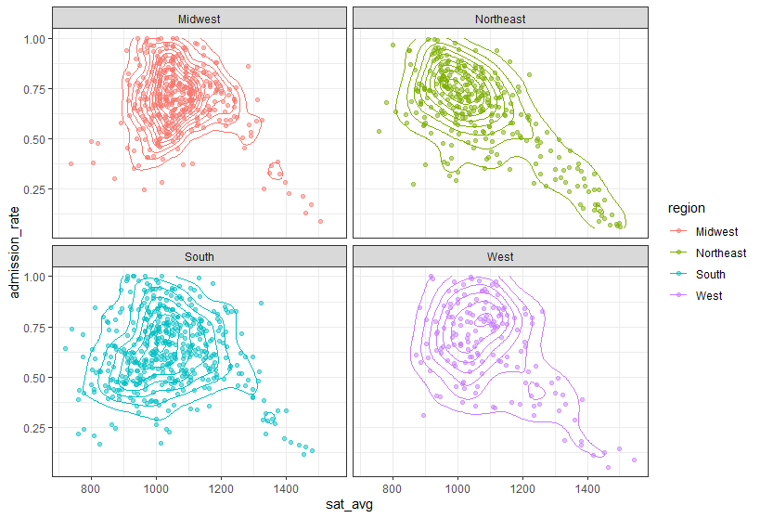
Refine your Scatter Plots
geom_density_2d
ggplot(college, aes(x=sat_avg, y=admission_rate, color=region)) + geom_point(alpha=0.5)+theme_bw()+facet_wrap(~region)+ geom_density_2d()
www.cdcs.ed.ac.uk

Slide 18
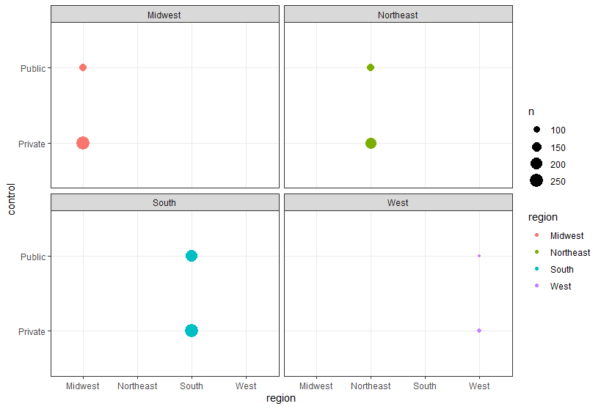
Assessing the incidence of the subplots
Bubble Graph
ggplot(college, aes(x=region, y=control, color=region))+ geom_count() +theme_bw()+facet_wrap(~region)
www.cdcs.ed.ac.uk

Slide 19
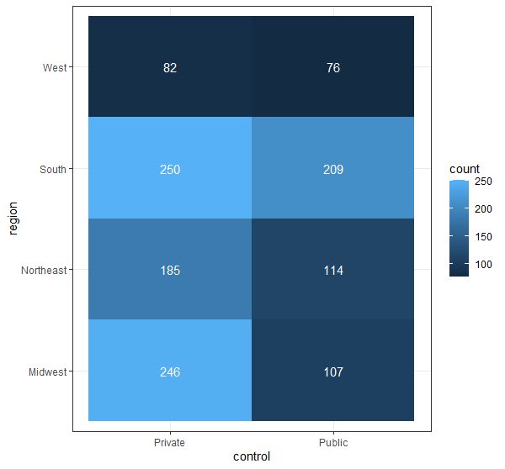
Assessing the incidence of the subplots
Heat map
ggplot(college, aes(x=control, y=region))+ geom_bin2d() +theme_bw()
www.cdcs.ed.ac.uk

Slide 20

Any Question?
www.cdcs.ed.ac.uk

Slide 21
Next Class
Hypothesis testing
Null-Hypothesis
Main types of tests
Limitations and corrections

Slide 22
Data Collection
https://www.scribbr.com/methodology/data-collection/
https://www.formpl.us/blog/data-collection-method
Sample and Population
https://www.youtube.com/watch?v=eIZD1BFfw8E
https://www.youtube.com/watch?v=DOnucdP7LNU
https://www.questionpro.com/blog/population-vs-sample/
Bias
https://www.statisticshowto.com/what-is-bias/
https://www.khanacademy.org/math/ap-statistics/gathering-data-ap/sampling-observational-studies/a/identifying-bias-in-samples-and-surveys
https://en.wikipedia.org/wiki/Survivorship_bias
Probability
https://en.wikipedia.org/wiki/Probability_theory
https://www.youtube.com/watch?v=KzfWUEJjG18
https://www.youtube.com/watch?v=pYxNSUDSFH4
Distributions
https://en.wikipedia.org/wiki/Normal_distribution
https://www.mathsisfun.com/data/standard-normal-distribution.html
https://www.youtube.com/watch?v=rzFX5NWojp0
Plots
https://www.r-graph-gallery.com/2d-density-plot-with-ggplot2.html
https://www.r-graph-gallery.com/320-the-basis-of-bubble-plot.html
https://www.r-graph-gallery.com/heatmap
References and other Resources

